Slide 1


Analyzing the Relative Resistances of the two unordinary 2D shapes using finite element analysis method
Erdem Canaz
Sophomore at ODTÜ,
Electiral & Electronics Engineer
November 11, 2020
Shared on youtube

Slide 2
Outline
Concepts that are used to model the analysis
Forming the data
Solving the equations
Visualizing the results
Comparing Resistances of the shapes

Slide 3
Concepts that are used in the analysis

Slide 4
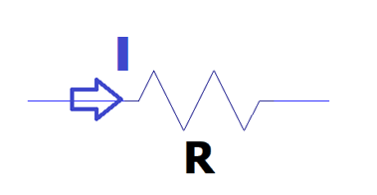

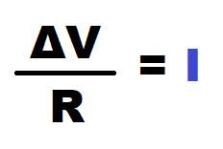
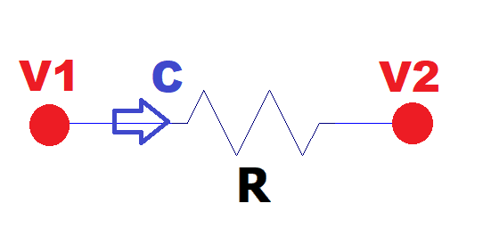
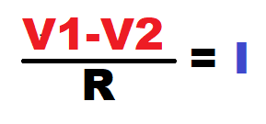
Expressing current I?
(Ohm’s Law)

Slide 5
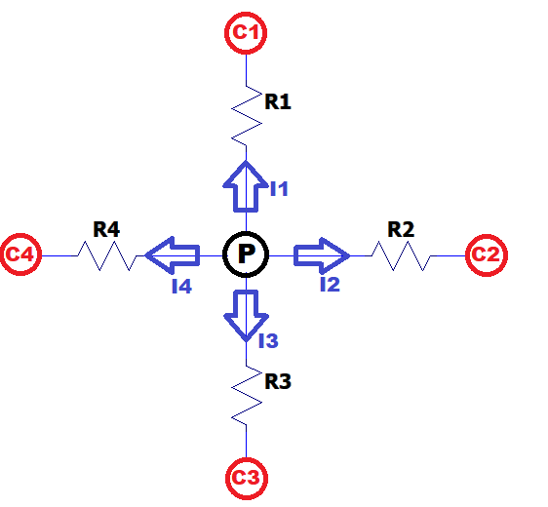
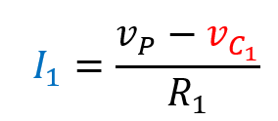
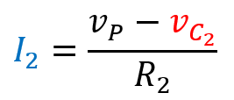
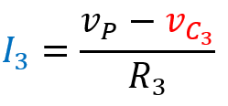
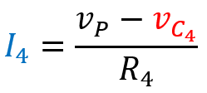
Node analysis method:

Slide 6
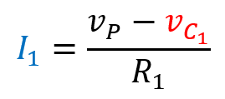
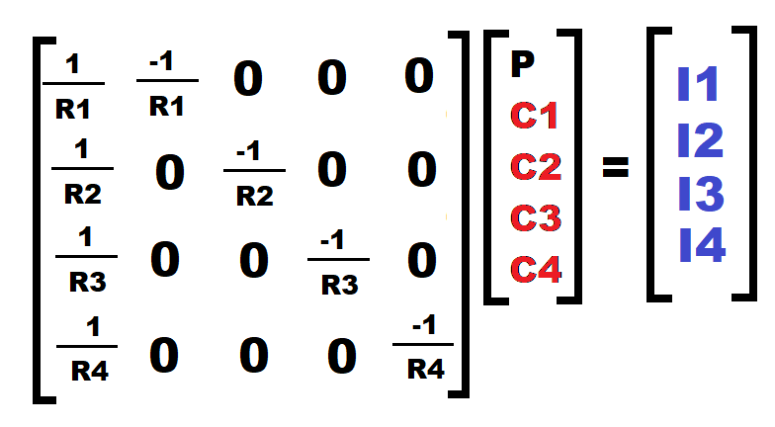
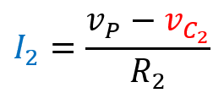
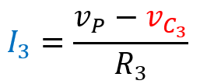
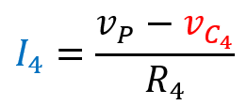

Slide 7
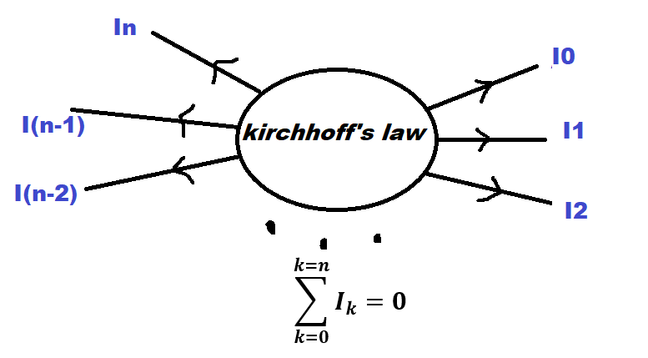


Slide 8
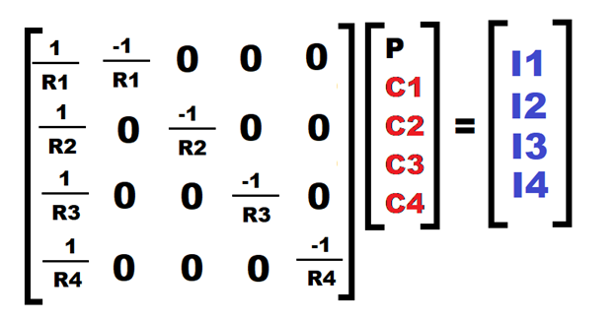
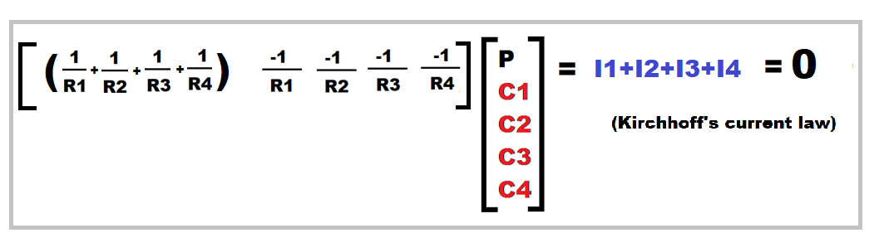

Slide 9
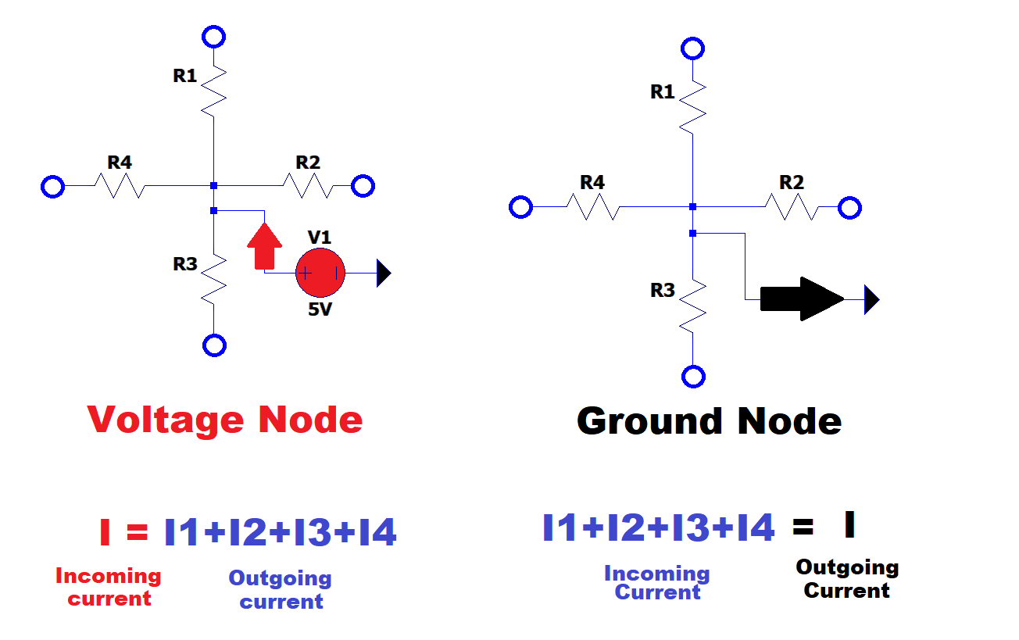
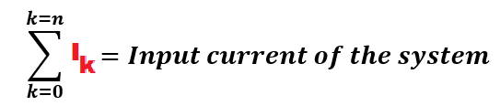
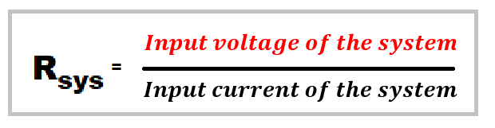

Slide 10
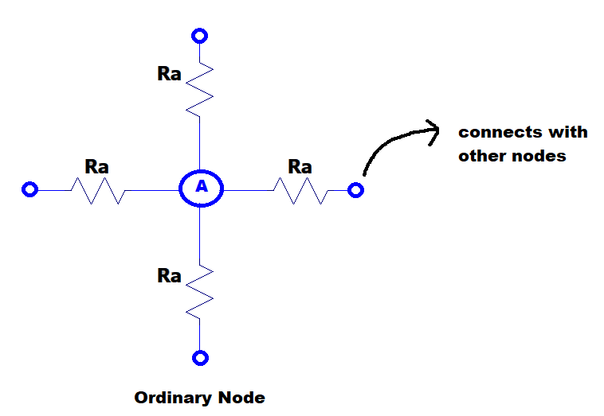

Slide 11
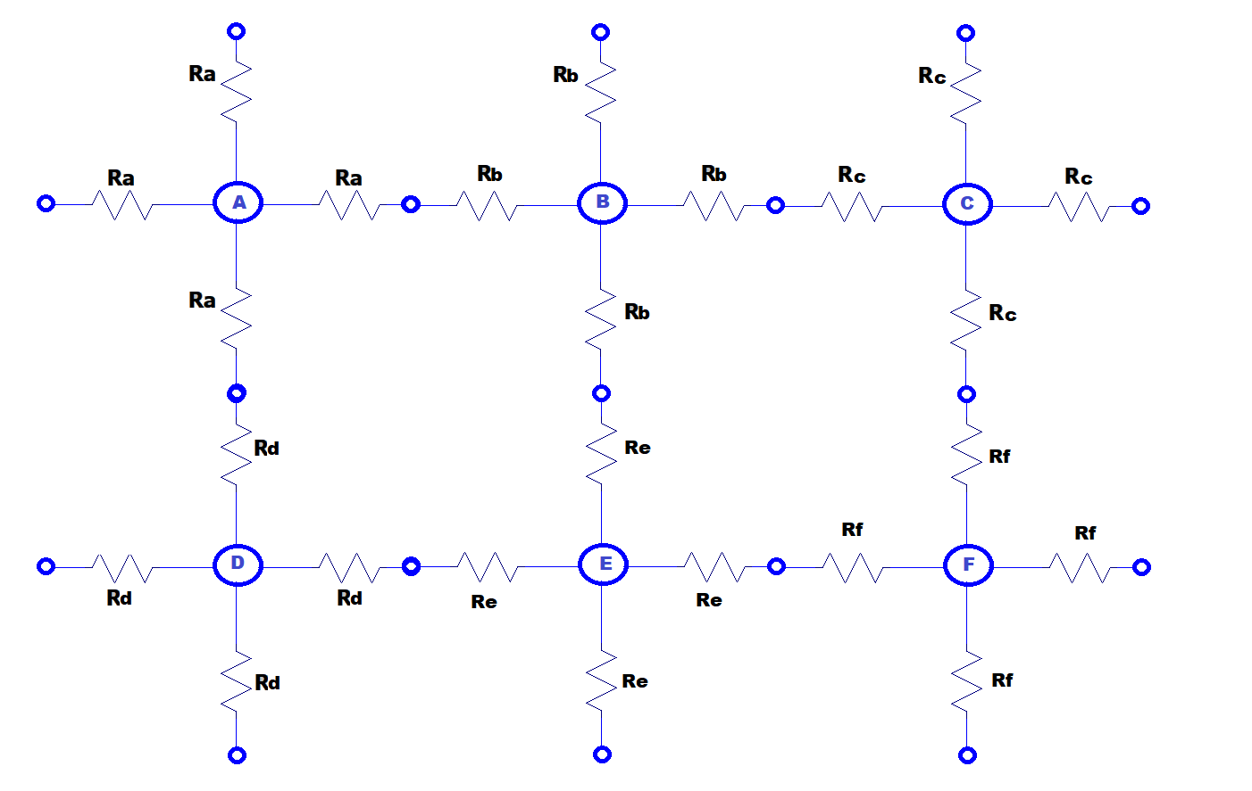
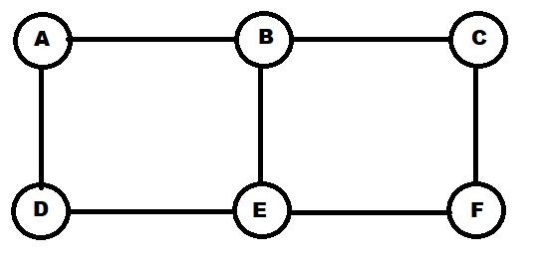
=

Slide 12
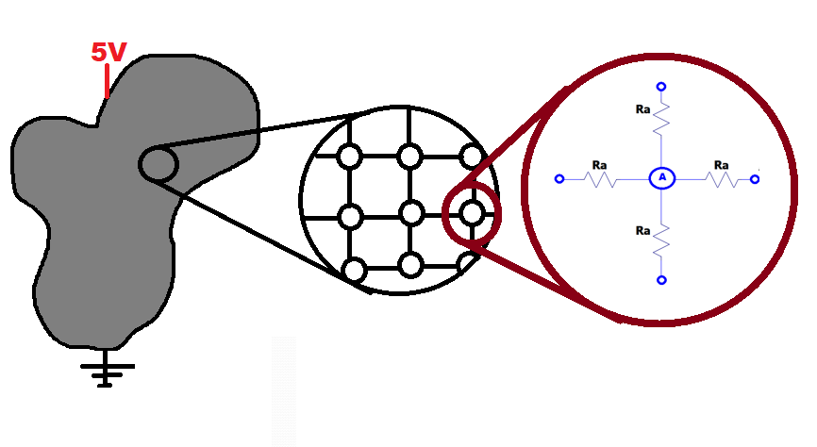

Slide 13
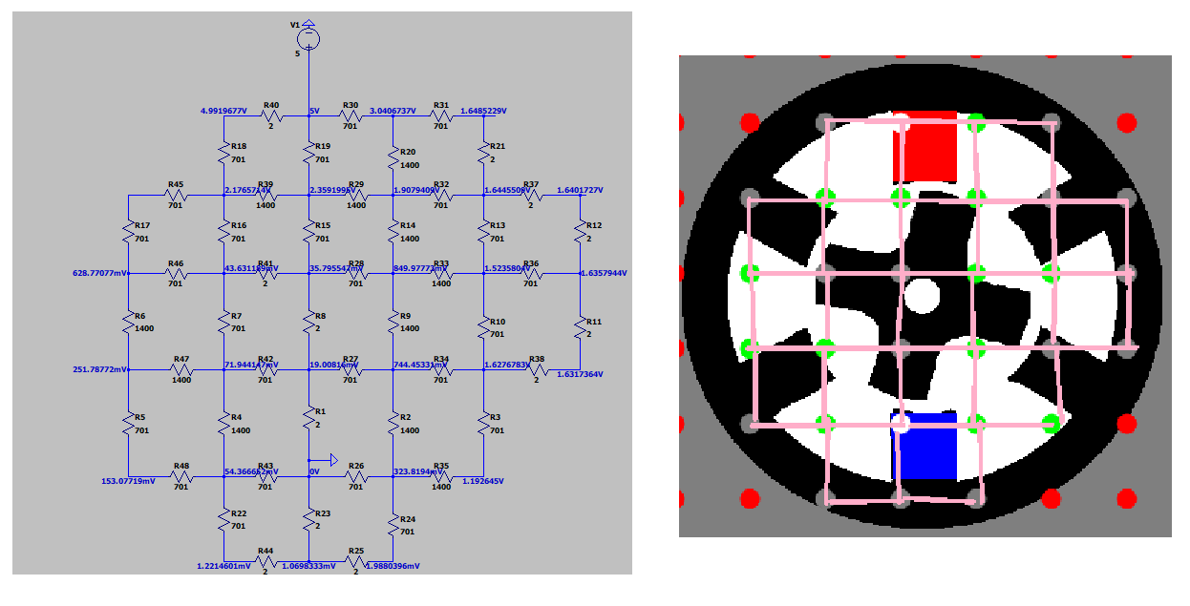

Slide 14
Forming the data

Slide 15
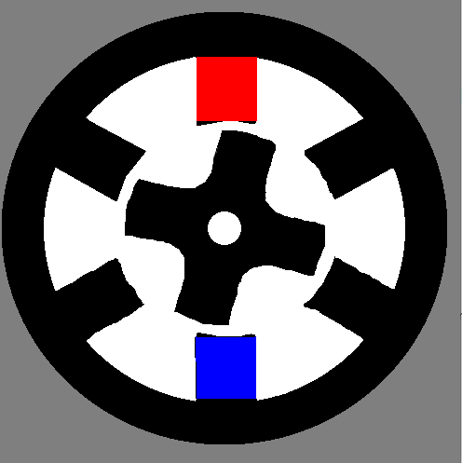
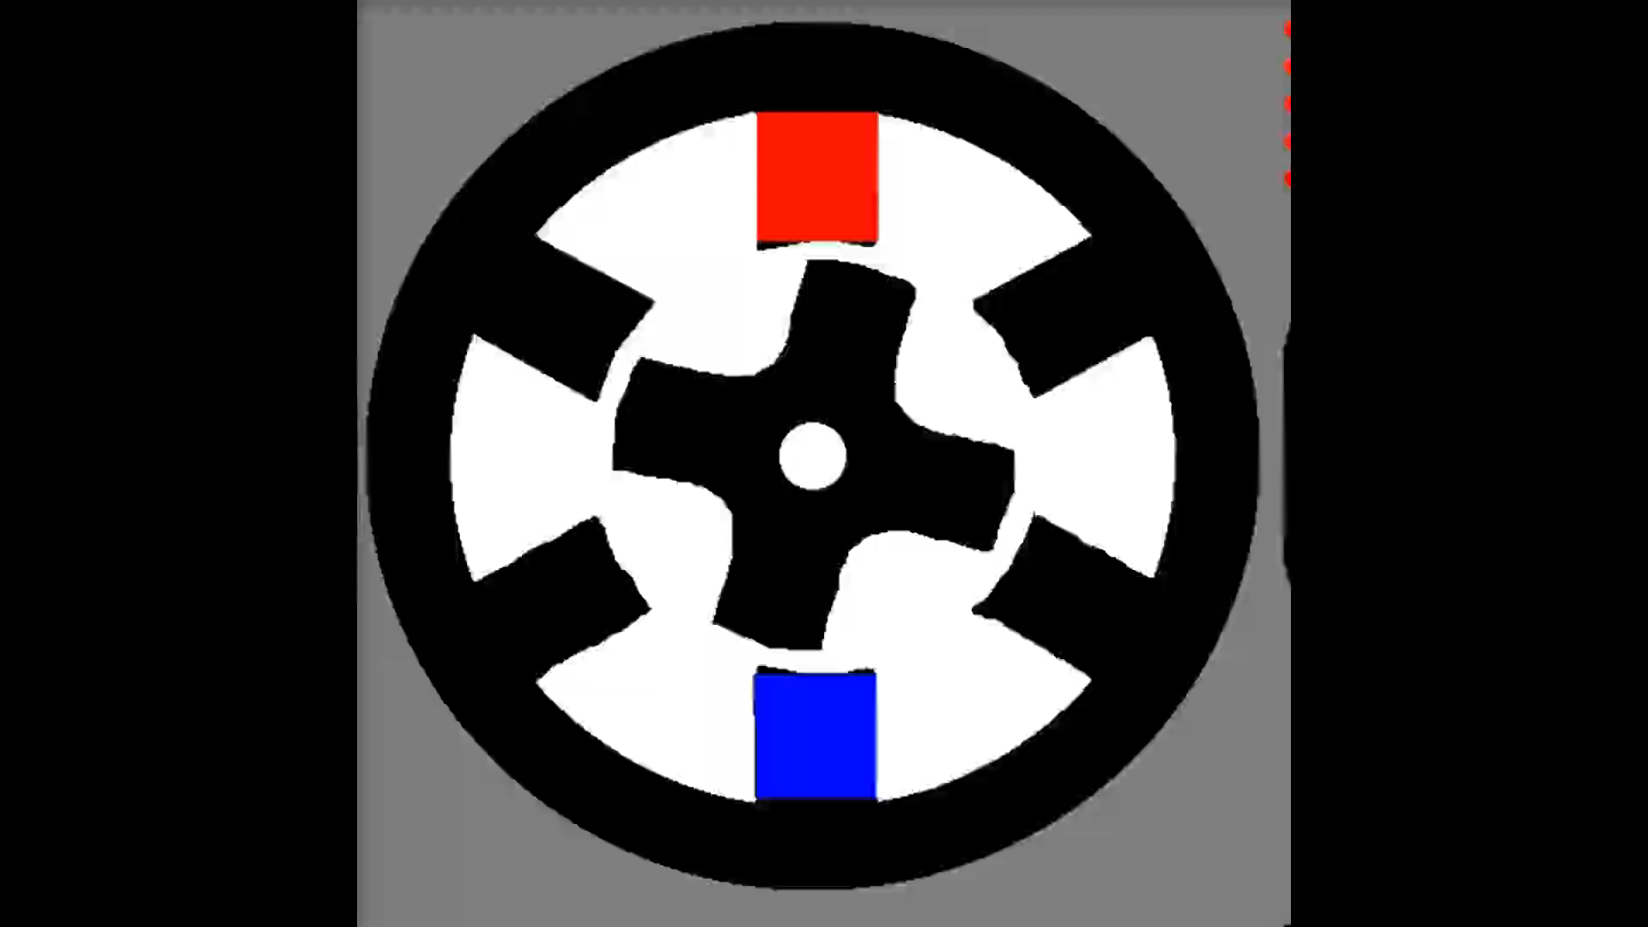
Grey (127,127,127):
Out of boundary
Black (0,0,0):
Low resistance material
White(255,255,255):
High resistance material
Red(255,0,0):
Voltage node
Blue (0,0,255):
Ground node

Slide 16
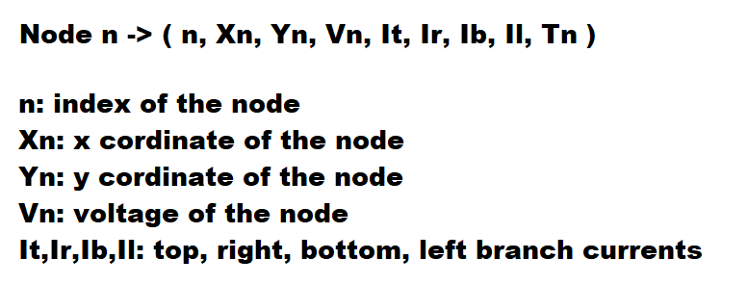

Slide 17
SOLVING THE EQUATIONS

Slide 18
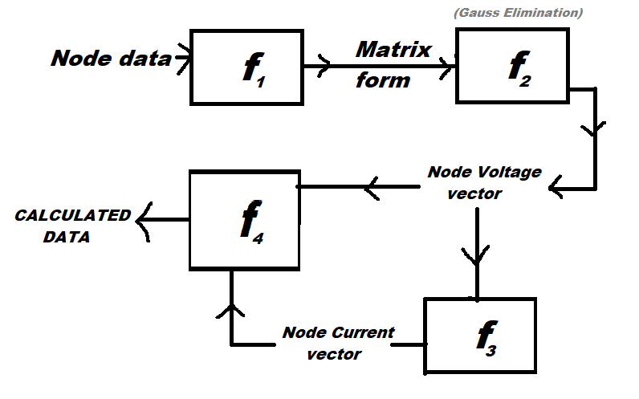

Slide 19
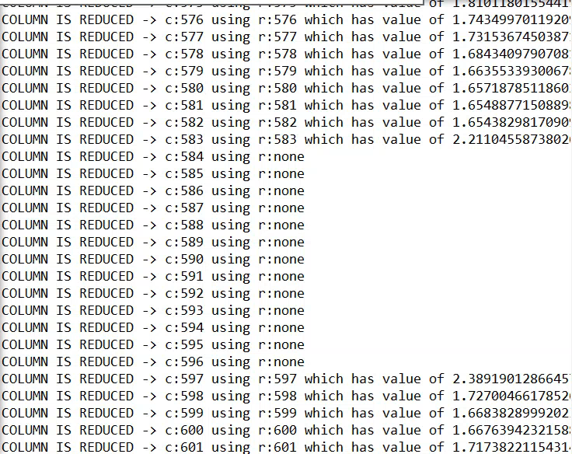
Solution must be unique !

Slide 20
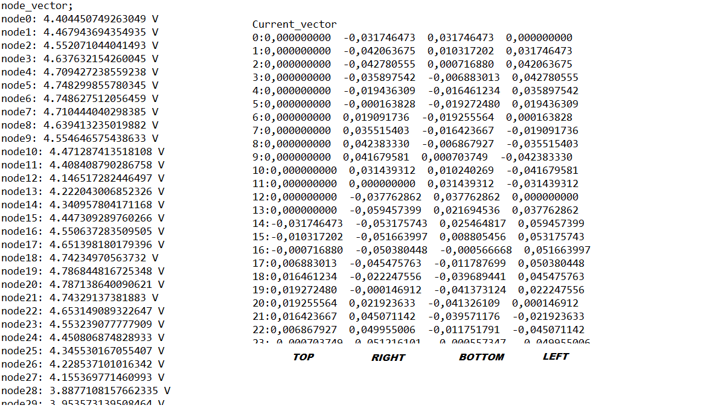
If sum of any of the branch currents is not zero
Node must be either voltage or ground node

Slide 21
Visualizing the results

Slide 22


Slide 23
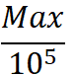
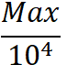
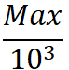
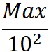
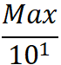
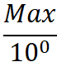
One should ask
Which data I am seeking for ?
How I may represent data with different magnitudes using limited amount of colours?
Should scale be logarithmic or linear ?

Slide 24

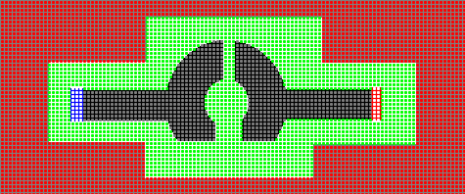



Current stress: Sum of incoming currents to a node
R_{air} = 1k unit
R_{iron} = 1 unit
R_{sys} = 9.68 unit
R_{air} = 500 unit
R_{iron} = 500 unit
R_{sys} = 1870 unit
R_{air} = 500 unit R_{iron} = 40 unit R_{sys} = 254 unit

Slide 25
Comparing resistances

Slide 26
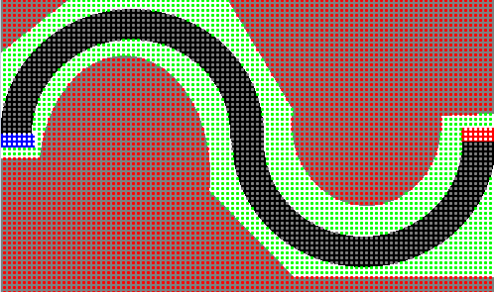
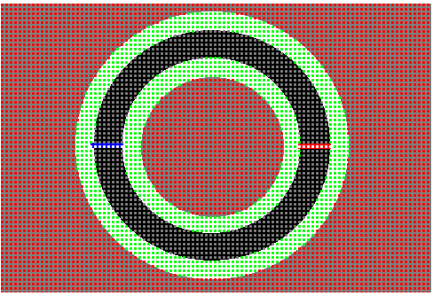
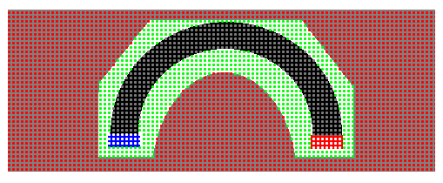



R= 49.8 unit
R= 24.9 unit
R= 12.3 unit

